Slide 1
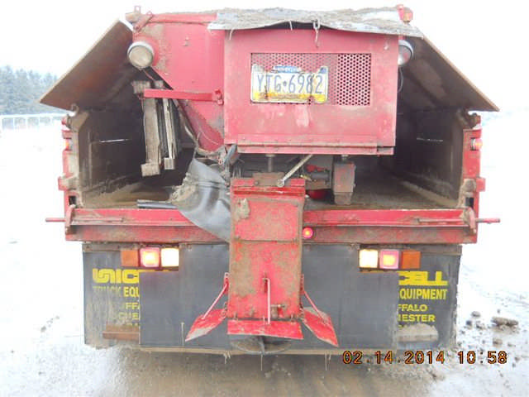
HS&E INCIDENT BULLETIN |  | 1st half year 2014
U.S. | Type of incident - Struck by vehicle
Summary:
Employee was traveling west on a designated walkway when he was struck by the right (passenger side) rear of a Contractor dump truck that was backing up spreading sand/salt to treat the snow and ice on the pavement. Employee was diagnosed with two fractured ribs.
Root Causes: | Actions Taken Thus Far: Next Steps
Uncovered channel creating uneven work surface. | Cover channels to eliminate uneven surfaces, use portable hoist instead of manually moving.

